Slide 1


DEPARTMENT OF ELECTONICS AND COMMUNICATION ENGINEERING
Galgotias College of Engineering s Technology
Automated Fire Detection and Suppression System
Mini Project (BEC554)- 5thSemester Electronics and Communication Engineering
Under the guidance of: Dr. Richa
Mr. Amit Gupta
Presented by:
Mohammad Azhar ( 2300970310111)
Mohd. Rehan Sharif (2300970310112)
Prakhar pal ( 2300970310126)

Slide 2
Table of Content
Introduction
Problem Identification
Objective
Literature Review
Proposed Method
Tool Used
Implementation
Result and Discussion
Applications
Limitation
Future Scope
Conclusion
References

Slide 3
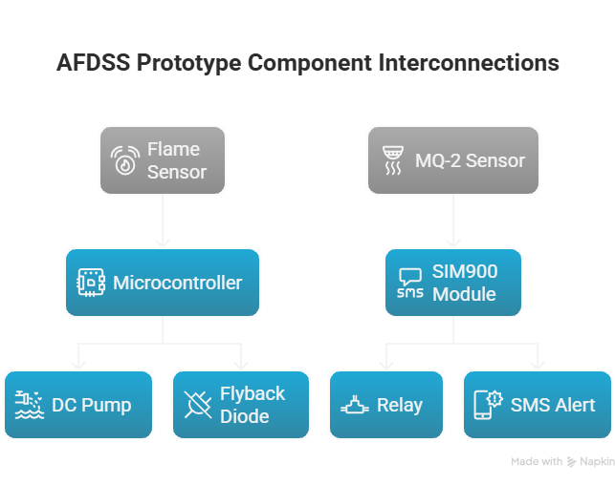
Introduction
Traditional fire safety relies on passive alerts, suffering fromcritical response delays and high rates of false alarms inherent insingle-
sensor systems.Its primary purpose is ensuring highreliability and stability through robust sensor fusion and a criticaldual-supply power architecture for managing high-currentinductive
loads and preventing system instability. The scopeincludes mandatory safety features, such as the flyback diode ,to protect the suppression circuitry and guarantee long-termoperational integrity.
This project details the design and implementation of anAutomated Fire Detection and Suppression System (AFDSS)prototype. The core of this system is the Arduino UNO R3microcontroller, which coordinates inputs from
a dual-sensorarray—comprising an IR Flame Sensor and an MQ-2 Gas/SmokeSensor [3]—with multiple output mechanisms. Thesemechanisms include a local audible alarm (5V Buzzer), a
remotealert system (SIM900 GSM module) [4], and an activesuppression module (5V DC Pump controlled by a 5V Relay).

Slide 4
Problem Identification
Conventional fire detection often relies soley on passive alams (buzzer /
siren) or human intervention, leading to delays in active suppression.
Without immediate, automated action, small fires can escalate rapidly, especially when systems rely only on a single sensor or inadequate power management.
A stable, reliable embedded system capable of:
Confirming fire or smoke presence using multiple inputs (Sensor Fusion).
Providing remote, real-time alerts (GSM).
Initiating immediate, timed, mechanical suppression (Water Pump).

Slide 5
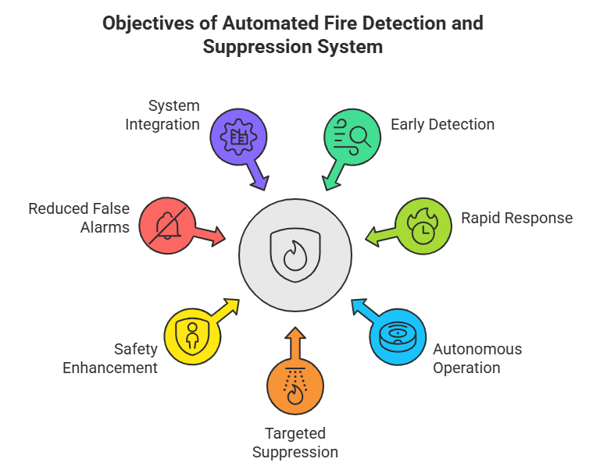
Objectives
Primary Objective: To design and implement a prototype Automated Fire Detection and Suppression System (AFDSS) using the Arduino UNO R3 platform and provided hardware components.
Detection Integrity: Implement a sensor fusion strategy (Flame + MQ-2) to maximize accuracy and minimize false positives.
System Stability: Engineer a dual-supply power architecture to isolate high-current inductive loads (Pump, GSM) and prevent system resets.
Safety Integration: Incorporate hardware protection (Flyback Diode) for inductive loads to ensure the longevity of switching components (Relay).
Response Protocol: Establish a non-blocking control logic for timed suppression and asynchronous GSM alerting.

Slide 6
Literature Review
Foundational Architecture and Sensor Integration
Established Architecture: Automated fire systems typically follow a three-module architecture: Detection, Alarm/Alert, and Suppression.
Common Detection Techniques: Microcontroller-based systems frequently rely on infrared flame sensors [6] and metal oxide gas sensors (MQ-series) to monitor fire and combustible gas concentrations.
Alert Mechanisms: Beyond local buzzers, remote notification via GSM modules (like the SIM900) has been established as an effective method for asynchronous remote warnings.
Project Advancement: This design improves upon the standard model by prioritizing electrical stability (power isolation) and operational robustness (sensor fusion) in a compact prototype.

Slide 7
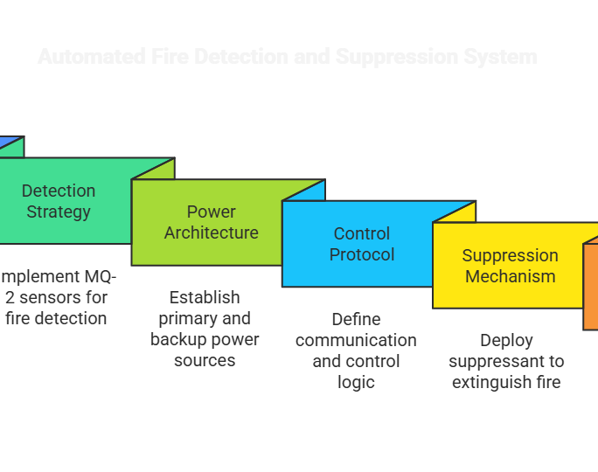
Proposed Model
Core Methodology: Dual-Supply and Sensor Fusion
Detection Strategy (Sensor Fusion): Suppression is activated only when the system confirms both high IR intensity (Flame Sensor) AND elevated gas concentration (MQ-2 Sensor) simultaneously.
Power Architecture (Dual-Supply):
12V Adapter: Dedicated to Arduino UNO R3 (Logic/Low Current Supply).
5V AC-DC Adapter: Dedicated to high-current peripherals (SIM900 GSM, Pump Load) for stability.
Control Protocol: Use non-blocking timing (millis()) to manage the fixed 10-second suppression cycle and prevent code lock-up caused by long delay() calls.
Suppression Mechanism: Digital pin D7 drives a 5V Relay, which acts as the high-side switch for the external 5V DC Pump power rail.

Slide 8
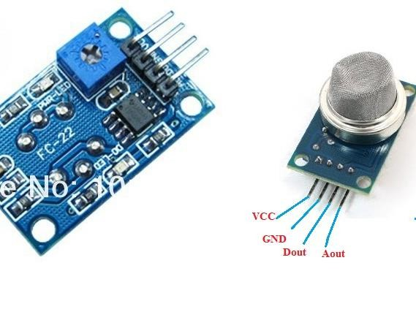
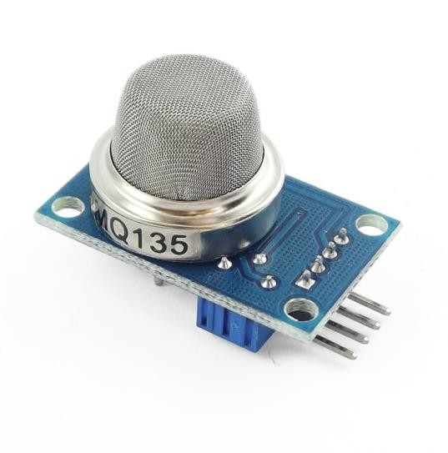
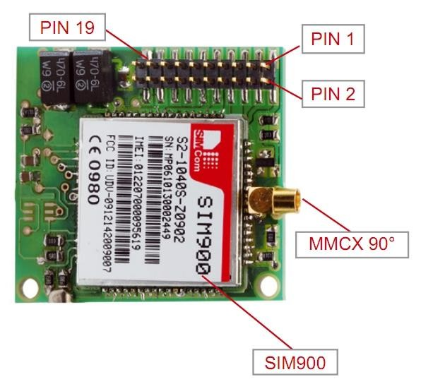
Tool Used
Hardware and Software Tools Inventor
Microcontroller: Arduino UNO R3
Detection Sensors (Input):
Flame Sensor (Analog Output A0)
MQ-2 Gas/Smoke Sensor (Analog Output A1)
Actuators (Output):
5V Buzzer (Audible Alarm, Digital D8)
5V Relay Module (Pump Control, Digital D7) 5V DC Pump (Suppression Mechanism)
Communication: SIM900 GSM module (Software
Serial D10/D11)
Power Supply s Accessories:
12V Adapter (for UNO)
5V AC-DC Adapter (for High-Current loads) Small Breadboards (x2), Female-Female Jumper
wires
Arduino Cable, 5V Relay
Software Environment:
Arduino IDE
(C/C++ language).

Slide 9
Implementation
(II): Suppression and Safety
Suppression Circuit Design and Electrical
(I): Interfacing and Pin Mapping
Hardware Interfacing and Component Connections
Detection Subsystem:
Protection
Relay Operation: Digital pin D7 triggers the 5V
Relay's control coil (low current side). [2]
Flame Sensor (AO) Arduino A0 (For intensity readings,
Pump Load Circuit: The high-current path is
0-1023 ADC)
isolated: External 5V AC-DCRelay Normally
MQ-2 Sensor (AO Arduino A1 (For gas concentration readings).
Alert Subsystem:
5V Buzzer (+)Arduino D8. [11]
SIM900 TXD Arduino D10 (SoftwareSerial RX). [2]
SIM900 RXDArduino D11 (SoftwareSerial TX). [2]
Power Allocation (Crucial Separation):
Open (NO) 5V DC Pump .External 5V AC-DC
Ground (-).
Critical Safety Feature: Flyback Diode:
A 1N4007 (or similar) diode is mandatory. [4]
It must be wired in reverse bias across the terminals (Cathode/band to positive, Anode to
pump motor
negative).
Purpose: To dissipate the high-voltage inductive
UNO’s Regulated 5V: Powers all sensors and the relay
spike generated when the pump (inductive
control coil.
load) is switched off, protecting the relay and
External 5V AC-DC Adapter: Powers the SIM900 VCC
preventing system resets
.
and the 5V DC Pump.
System Grounding: Utilize Ground Fault Circuit
Interrupter (GFCI) protection for all AC-DC
adapters due to the use of liquid and electrical
components. [13]

Slide 10
Result and Discussion
(I): Calibration and Fusion • (II): System Stability
Detection Reliability
Electrical Integrity
MQ-2 Stabilization: Accurate operation requires
Power Isolation: The successful implementation of the dual-supply architecture contained current spikes from the SIM900 and pump startup, preventing the voltage fluctuations that commonly cause instability or system resets in embedded projects.
Inductive Load Management: The flyback diode proved essential in mitigating back EMF, ensuring the consistent operation of the relay and the micro- controller logic during the suppression cycle shutdown.
GSM Alert Reliability: The robust power supply dedicated to the SIM900 ensures sufficient current for high-peak transmission requirements, leading to reliable SMS delivery during the critical alert phase.
rigorous pre-heating: a 20-second delay in
setup() and, ideally, a 24-48 hour burn-in for optimal long-term stability.
Threshold Benchmarking:
MQ-2 Fire Threshold: Analog reading consistently
ADC units. [10, 7]
>
Flame Sensor Fire Threshold: Analog consistently <
150 ADC units.
Sensor Fusion Outcome: By requiring
simultaneous confirmation from both sensors, the
system effectively avoids false alarms caused by
non-fire vapors (MQ-2 only) or ambient infrared
light (Flame sensor only), significantly enhancing
detection reliability.

Slide 11
Application ,Limitation and Future Scope
Application: This system serves as a functional prototype for small-scale, non-critical environments (e.g., hobbyist projects, academic demonstration) or as a tertiary alert mechanism.
Critical Limitation: Dry Run Risk: The current design lacks Dry Run Protection. Operating the 5V DC pump without water will lead to rapid overheating and mechanical failure.
Future Scope : Integrating persistent, non-volatile memory (EEPROM or SD card) to log fire events and SMS transmissions for enhanced auditing capabilities.

Slide 12
Conclusion
This prototype is constrained by its components and is not compliant
with industrial or regulatory safety standards (e.g., NFPA or OSHA). Professional systems require certified components and mandated annual inspections.
Key Conclusion: The project successfully engineered a stable, functional prototype by employing crucial design principles:
Dual-Sensor Fusion for confirmed fire detection. Dual-Supply Power Isolation for electrical stability.
Flyback Diode Protection for inductive load management.
Overall Achievement: A reliable foundation for automated fire detection, alert, and suppression has been established, ready for the critical addition of dry run protection.

Slide 13
References
Cited Works and Research Material
[1] Pushpa, Kumar and. Bhulaxmi, 2020. Block diagram for the fire detecting System in library.
[2] Circuit Digest, How to Build a Fire and Smoke Alarm Using Arduino with SMS Notifications.
[3] Circuit Designer, Arduino code for fire suppression system with timed pump operation and
threshold setting.
[4] Arduino Forum, Controlling 12V 2A Max DC Water Pump With Arduino Uno.
[5] IJARIIE, Fire Detection system using Arduino.
[6] Arduino Forum, Fire Detection Using Arduino and Flame Sensor.
[7] TechPonder, Flame sensor interfacing to Arduino.
[8] The Geek Pub, KY-026 flame IR sensor.
[9] Instructables, Flame detection using Arduino and flame sensor.
[10] Forum All About Circuits, Flyback diodes and why you need them.
[11] Sunfounder, Calibrating the MQ2 Gas Sensor.
[12] IEM Robotics, Understanding MQ2 Gas Sensor: A Guide for Beginners.

